Slide 1
Baptism Series I:
A Positive Case for Biblical Baptism

Slide 2
Local numbers

Slide 3

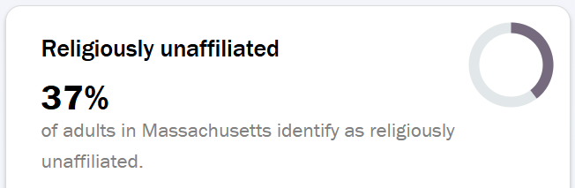
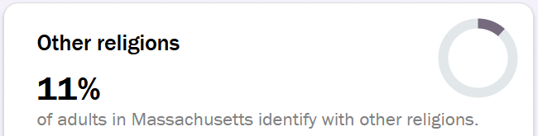
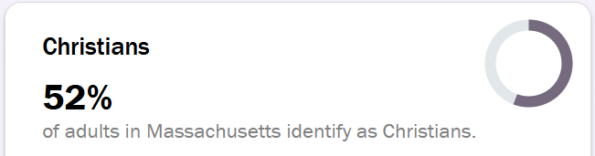

Slide 4

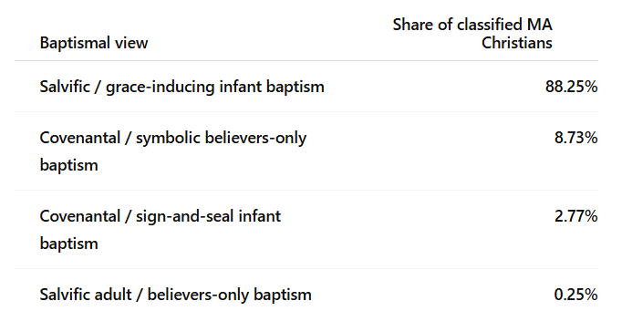

Slide 5
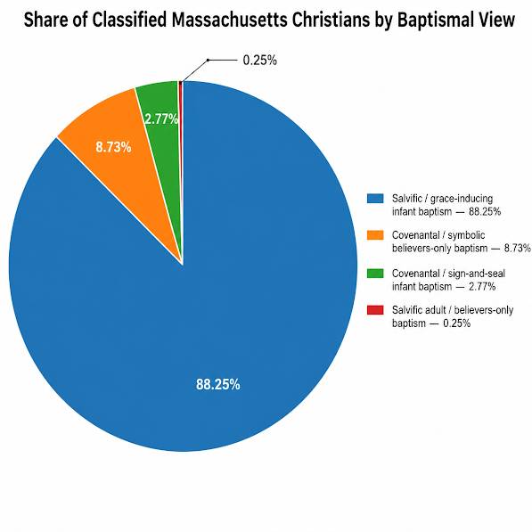

Slide 6
The Algorithm

Slide 7
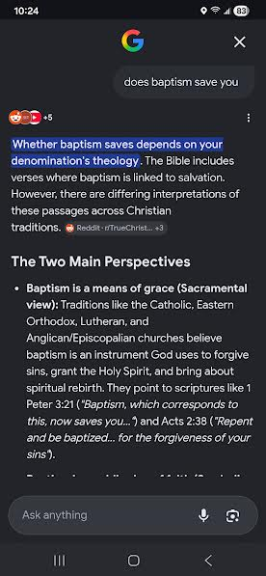
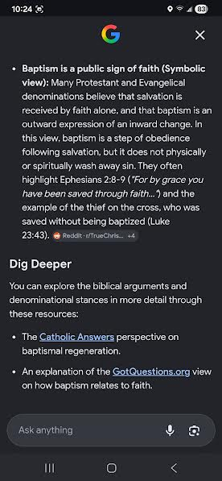

Slide 8
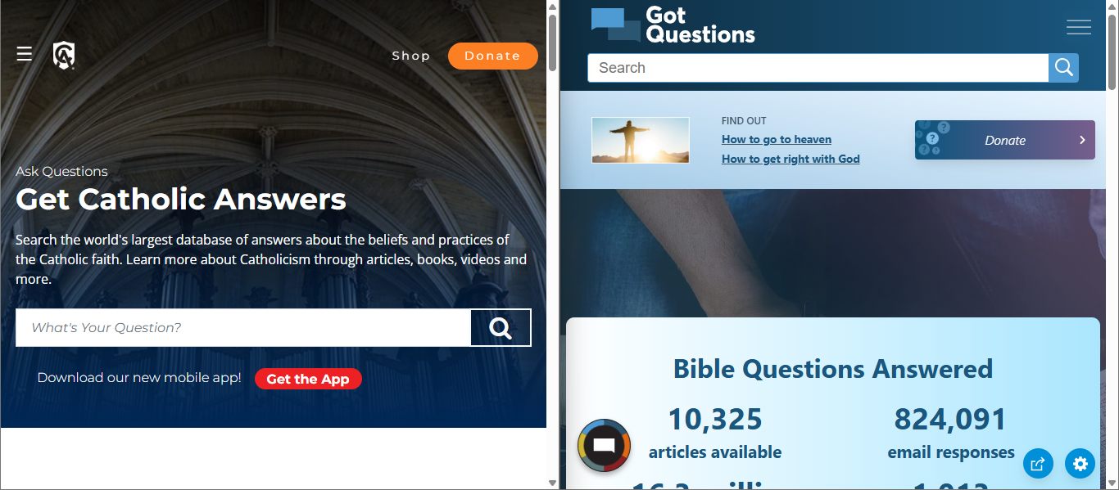

Slide 9
Who are the Baptists & Paedobaptists

Slide 10
Baptists practice believer’s baptism, viewing baptism as an outward symbol of a person’s personal saving faith in Jesus— performing it after salvation as an act of obedience.

Slide 11
Paedobaptists practice infant baptism, *(generally) viewing baptism as a means of grace that grants the seed of faith, or even saving faith, in the hearts of baptized infants.

Slide 12
Paedobaptists practice infant baptism, *(generally) viewing baptism as a means of grace that grants the seed of faith, or even saving faith, in the hearts of baptized infants.
*Some Paedobaptists (Presbyterians, Congregationalists) practice an infant baptism which views baptism as a covenant sign that marks the children of believers as belonging to God’s visible people, to be later personally embraced by faith.

Slide 13
The Divide

Slide 14
From Brother Frank’s Intro to Apologetics:
Worldview (n.) –
“the filter we use to understand the world around us.”

Slide 15
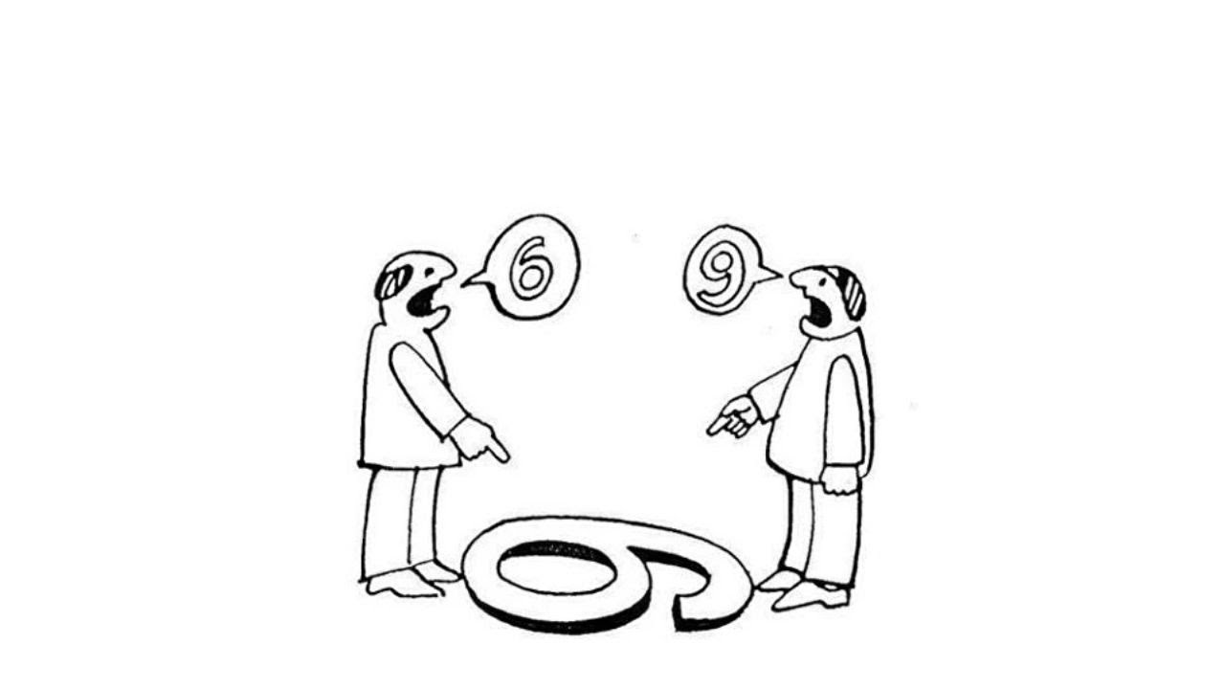
“Two people with different backgrounds see the same thing entirely differently”
-Brother Frank

Slide 16
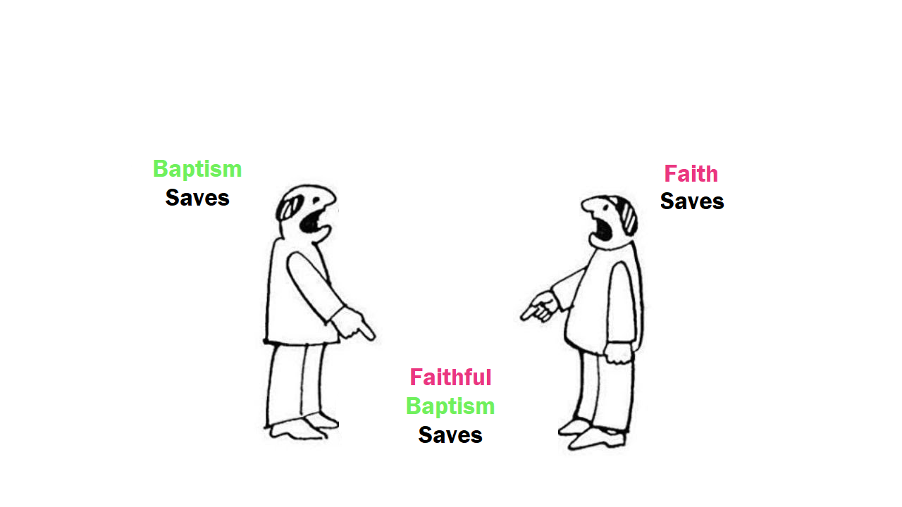
Paedobaptist
Baptist
Bible

Slide 17
While both groups emphasize important aspects of God's
word; Baptists, faith —and Paedobaptists, baptism:
“The sum of your word is truth.”
Psalm 119:160

Slide 18
A Cause for Confidence:
1. Every passage that says what baptism does says that baptism saves.

Slide 19
A Cause for Confidence:
1. Every passage that overtly says what baptism does says that baptism saves.
2. Every passage that overtly says that baptism saves ties this salvation to the participant’s faith, active amidst baptism.

Slide 20
“Always be prepared to make a defense to anyone who asks you for a reason for the hope that is in you; yet do it with gentleness and respect.”
1 Peter 3:15

Slide 21
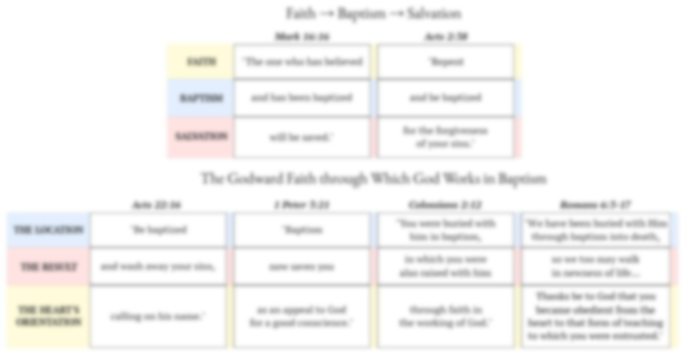
A Positive Case for Biblical Baptism

Slide 22
Mark 16:15
Then he [Jesus] said to them [the apostles],
“Go into all the world and preach the gospel to all creation…”

Slide 23
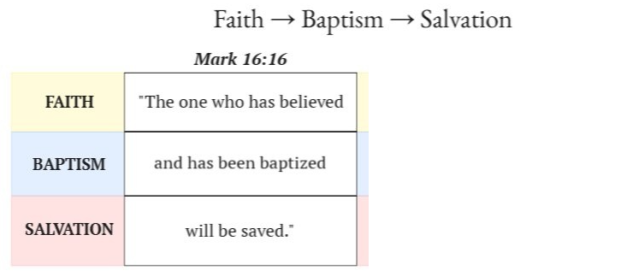

Slide 24
Baptists claim the believer is saved before, or without, baptism.
Paedobaptists claim, with infants, that the unbeliever is saved by baptism.

Slide 25
Pastoralis action (From the the Vatican)
INSTRUCTION ON INFANT BAPTISM
“The fact that infants cannot yet profess personal faith does not prevent the Church from conferring this sacrament on them… the child who is baptized believes not on its own account, by a personal act, but through others, "through the Church's faith communicated to it." This same teaching is also expressed in the new Rite of Baptism, when the celebrant asks the parents and godparents to profess the Faith of the Church, the Faith in which the children are baptized.”

Slide 26
Lutherans claim that the participant is saved by faith alone, therefore baptism gives the participating infant saving faith, so the implied reading is:
“The one who is baptized
has faith created in them
that receives the salvation baptism gives to faith.”

Slide 27
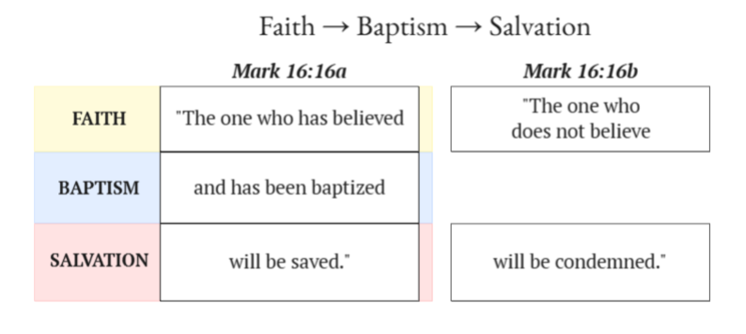
The Baptist Objection:
“but Jesus does not say that the unbaptized will be condemned.”

Slide 28
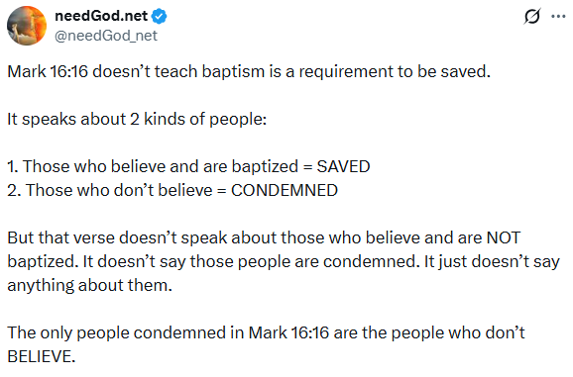

Slide 29
Therefore:
“And baptism is only mentioned here because believers are typically baptized.”

Slide 30
The one who
ⓐ gathers wood and
ⓑ ignites it
🗹 will have a bonfire
The one who does not
ⓐ gather wood
ⓧ will not have a bonfire.
The one who
ⓐ enrolls in college courses and
ⓑ completes course requirements
🗹 will get a degree.
The one who does not
ⓐ enroll in the college course
ⓧ will not get a degree.
The one who
ⓐ sows seeds and
ⓑ tends his garden
🗹 will grow a crop.
The one who does not
ⓐ sow seeds
ⓧ will not grow a crop.
The one who
ⓐ looks intently into the
perfect law of freedom and
ⓑ perseveres
🗹 will be blessed in what he does. [James 1:25]
The one who does not
ⓐ look intently into the perfect law of freedom
ⓧ will not be blessed in what he does.

Slide 31
The one who
ⓐ gathers wood and
ⓑ ignites it
🗹 will have a bonfire
The one who does not
ⓐ gather wood
ⓧ will not have a bonfire.
The one who
ⓐ enrolls in a college course and
ⓑ completes course requirements
🗹 will get college credits.
The one who does not
ⓐ enroll in the college course
ⓧ will not get college credits.
The one who
ⓐ sows seeds and
ⓑ tends his garden
🗹 will grow a crop.
The one who does not
ⓐ sow seeds
ⓧ will not grow a crop.
The one who
ⓐ looks intently into the
perfect law of freedom and
ⓑ perseveres
🗹 will be blessed in what he does. [James 1:25]
The one who does not
ⓐ look intently into the perfect law of freedom
ⓧ will not be blessed in what he does.
ⓑ can only be done by those who have done ⓐ.

Slide 32
baptism can only be received by those who have believed.
~will not be- and can not be
baptized, ergo they~

Slide 33
baptism can only be received by those who have believed.

Slide 34
Jesus is clear.
Matthew 28:19-20:
He said: “Therefore go and make disciples of all nations, baptizing them in the name of the Father and of the Son and of the Holy Spirit, and teaching them to obey everything I have commanded you. And surely I am with you always, to the very end of the age.”
What did the apostles command?

Slide 35
Acts 2:14-36,
Peter Preached His First Sermon
V:36-38:
“Therefore let all the house of Israel know with certainty that God has made this Jesus, whom you crucified, both Lord and Messiah.”
When [the crowd] heard this, they were pierced to the heart and said to Peter and the rest of the apostles, “Brothers, what should we do?
Peter replied, “Repent and be baptized, each of you, in the name of Jesus Christ for the forgiveness of your sins, and you will receive the gift of the Holy Spirit.”

Slide 36
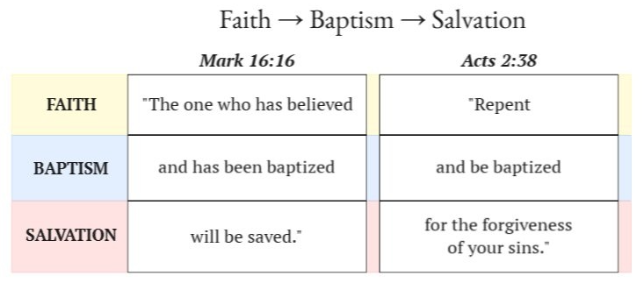

Slide 37
Paedobaptists claim, with infants, that the unrepentant
baptized person receives the forgiveness of sins.
This interpretation rejects the sum of the passage.

Slide 38
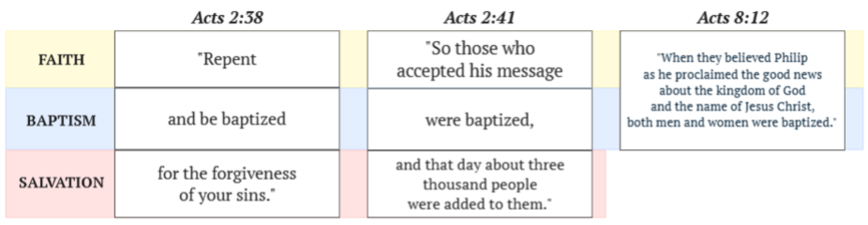
Another brief note:
Only believers were baptized that day.

Slide 39
Baptists claim that the unbaptized repentant person receives the forgiveness of sins prior to baptism.
This is sometimes justified by saying “for” means “because”,
like it can in English,
as in the sentence:
“Be rewarded for
your bravery”
because

Slide 40
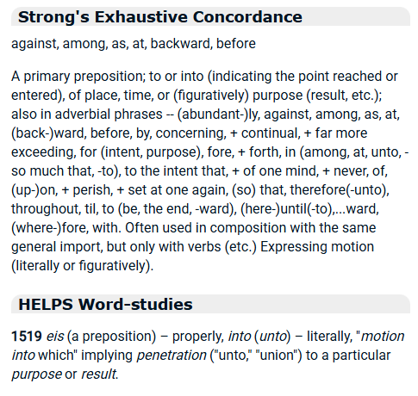
Does ε iζ mean “because”?

Slide 41
“When it comes to Acts 2:38,
no serious grammarians [believe in a causal ε iζ] today.”
Dr. Tom Schreiner
Christian Standard Bible Translator

Slide 42
What “For The Forgiveness of sins” means in the New Testament:
Luke 24:46-47
“The Messiah will suffer and rise from the dead the third day, and Repentance for forgiveness of sins will be proclaimed in his name to all the nations, beginning at Jerusalem.”
Matthew 26:28
“For this is my blood of the covenant,
which is poured out for many for the forgiveness of sins.”
“FOR”: Because of?

Slide 43
If you were in hearing these words from Jesus or Peter in the 1st century and decided to be baptized- in obeying these words- would you approach baptism believing you’d be saved by God in baptism?

Slide 44
Naturally. So if a believer obeys the pattern set forth by Jesus & Peter above, entering baptism intent on salvation, they naturally approach baptism with a heart that trusts God to act in that moment to save them.

Slide 45

is not only implied by the above, but is demonstrated throughout scripture:

Slide 47
Baptists claim that calling on the name of the Lord outside of baptism washes away sins
Paedobaptists claim that being baptized without the participant calling on the name of the Lord washes away sins

Slide 48
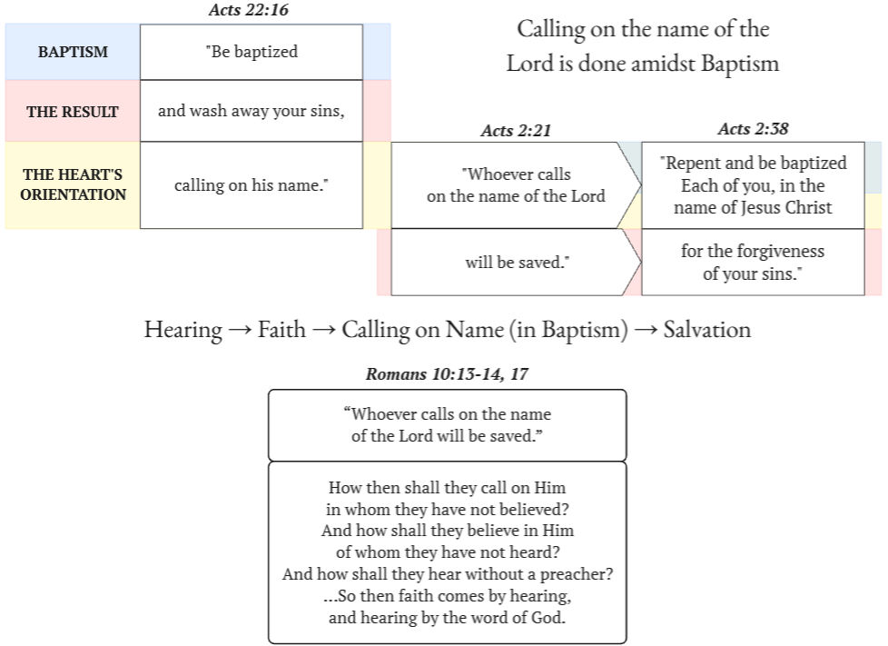

Slide 49
Here Peter finishes reminding a crowd of
what was prophesied by Joel in Joel 2, teaching the crowd that this precise prophecy was being fulfilled that very day.
He immediately follows this by preaching the prophetic fulfillment of “Jesus the Nazarene”, “who God has made both Lord and Christ.” After preaching the gospel,
he tells the crowd:

Slide 50
Which is to say, Joel 2:32 was being fulfilled that day
through the command of Acts 2:38

Slide 51
Joel 2:32 is only quoted in one other place in the New Testament

Slide 52
Joel 2:32 is only quoted in one other place in the New Testament

Slide 54
Hearing the word preached → Believing → Calling on the name of the Lord = → Salvation

Slide 55
Hearing the word preached → Believing → Calling on the name of the Lord = → Salvation
In response to the Baptist:
The moment of salvation here is not at the moment of faith, but with the calling which follows afterwards-
a moment both Ananias and
Peter above tie to baptism.
In response to the Paedobaptist:
an infant does not hear the gospel preached and thereby believe it, therefore they are not led to call on the name of the Lord.

Slide 56
Peter also ties calling on the name of the Lord to baptism elsewhere,
in 1 Peter 3:21

Slide 57
Z
Paedobaptists claim that a baptism without the participant’s appeal saves you
Baptists claim a personal appeal
outside of baptism saves you
Both disbelieve the sum of the passage.

Slide 58
A few other objections arise:
Is baptism a symbol?

Slide 59
1 Peter 3:20-21 (NIV)
“God waited patiently in the days of Noah
while the ark was being built.
In it only a few people, eight in all,
were saved through water (ὕδατος, hydatos),
and this water (ὃ, ho - “which” or “this”)
symbolizes baptism that now saves you also.”

Slide 60
1 Peter 3:20-21 (“ho” translated literally)
“…[eight people] were saved through water
*which* symbolizes baptism that now saves you also.”
Peter's point is that the flood waters function as a type or symbol
that points forward to the baptism which now saves you.
In other words- Baptism is not a symbol.
The flood waters are a symbol of baptism in water, which saves.

Slide 61
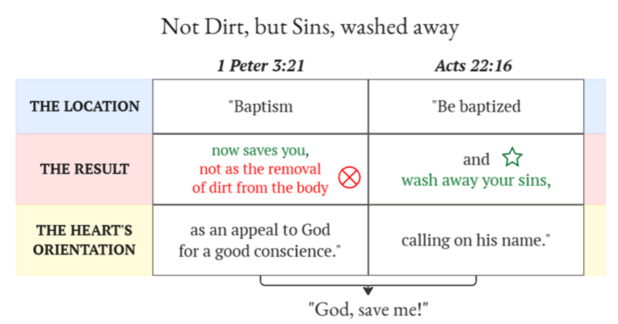
Another common objection:
“The full passage says that ‘baptism saves,
not as the washing away of dirt from the body’
but
Therefore, the baptism in water does not in any way save, but the appeal to God itself does.”

Slide 62
but

Slide 63
but

Slide 64
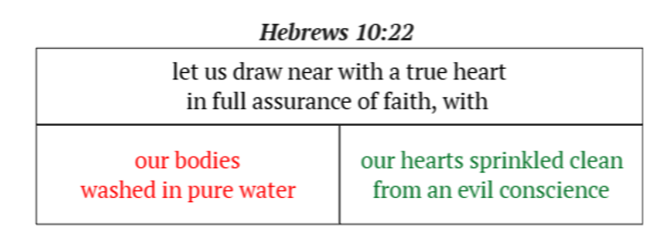
but
While of course both are cleansed in baptism

Slide 65
but

Slide 67
Baptists claim one is raised with Christ through faith before baptism.
Paedobaptists claim, with infants, that one is raised with Christ by baptism without personal faith.

Slide 68
Neither system can contend well with the idea that the participant’s faith in the working of God raises them in baptism
Except to say, “does that make baptism a work of man?”

Slide 70
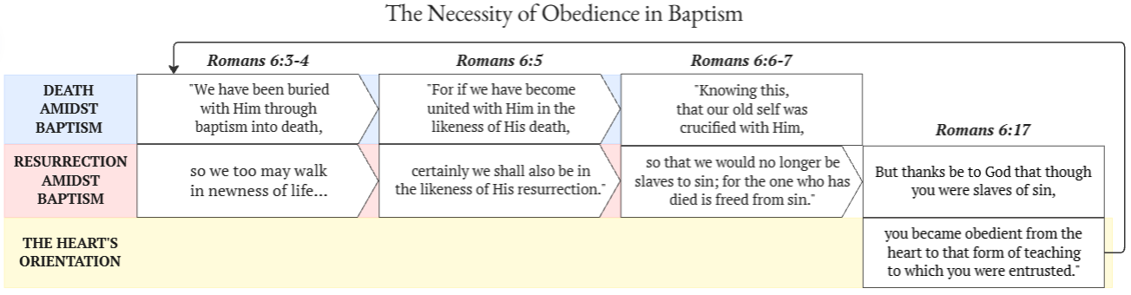

Slide 71
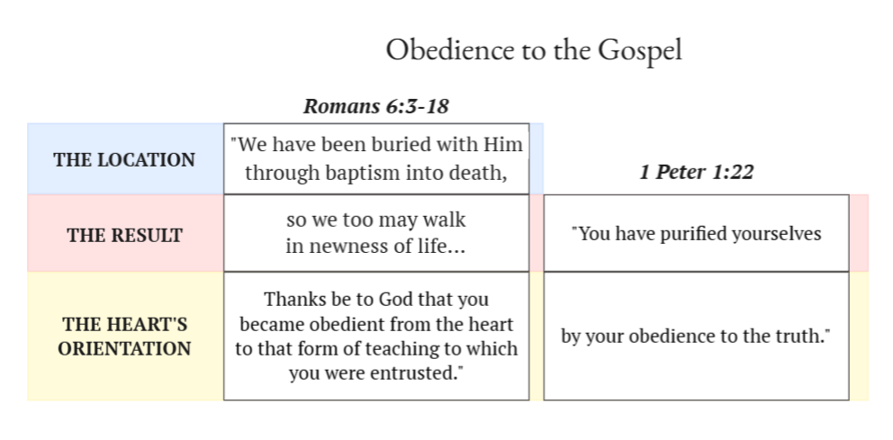

Slide 73
Challenge for Baptists:
Find a Bible passage that says what baptism does that does not say that baptism saves.

Slide 75
Challenge for Paedobaptists:
Challenge for Baptists:
Find a Bible passage that says what baptism does that does not say that baptism saves.
Find a Bible passage that says that baptism saves that does not tie this salvation to the participant’s faith, active amidst baptism.

Slide 77
Challenge for Paedobaptists:
Challenge for Baptists:
Find a Bible passage that says what baptism does that does not say that baptism saves.
Find a Bible passage that says that baptism saves that does not tie this salvation to the participant’s faith, active amidst baptism.
For Presbyterian & Congregationalist Paedobaptists:
Both challenges stand.

Slide 79
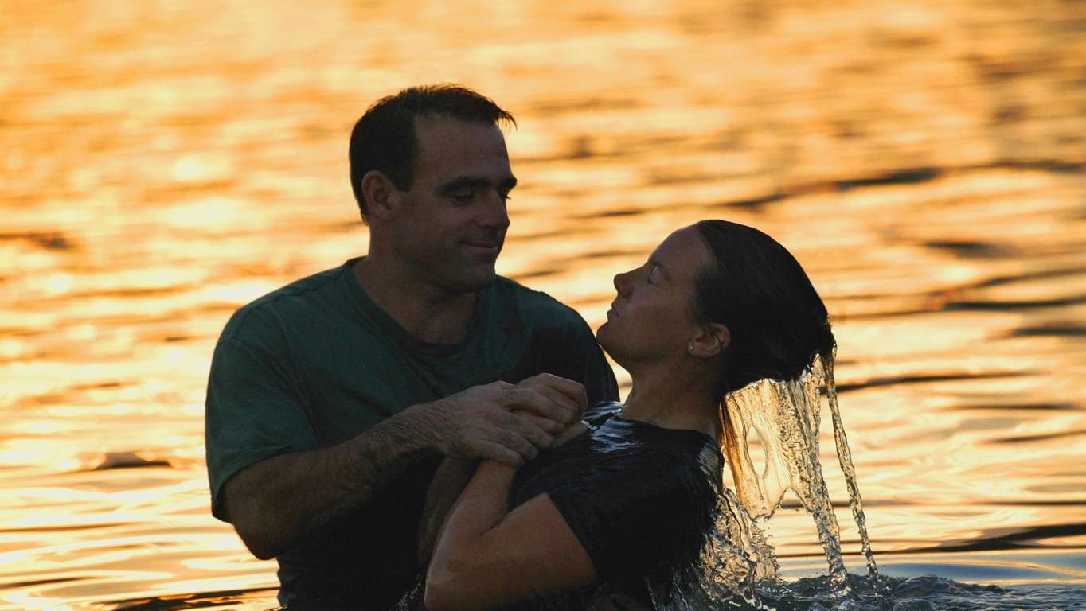
In the moment of baptism, did you entrust yourself to God, believing He was doing something spiritually for you that you could not do for yourself?
If the answer is no, or you are uncertain, have no shame in seeking to obey the biblical pattern of baptism "for (unto) the forgiveness of sins" (Acts 2:38)
Be baptized with a clear and Godward heart, calling out to God with trust
that He will act in that moment to unite you with Christ— and He will.

Slide 80
next week:
Baptism Series II:
Answering Baptist Arguments:
Paul
Cornelius
The thief on the cross
Ephesians 2:8-9
The Romans Road
& more

Slide 81
June 21:
Baptism Series III:
Answering Paedobaptist Arguments:
The promise "for your children”
The baptism of households
Original Sin/Inherited Guilt

Slide 82
June 28:
Baptism Series IV:
History & Other Addendums:
The two sides of every baptism passage
The baptismal theology of the 2nd Century church
Infant Innocence in the 2nd Century church
The Gnostic rejection of a baptism that saves
& more

Slide 83
